Slide 1
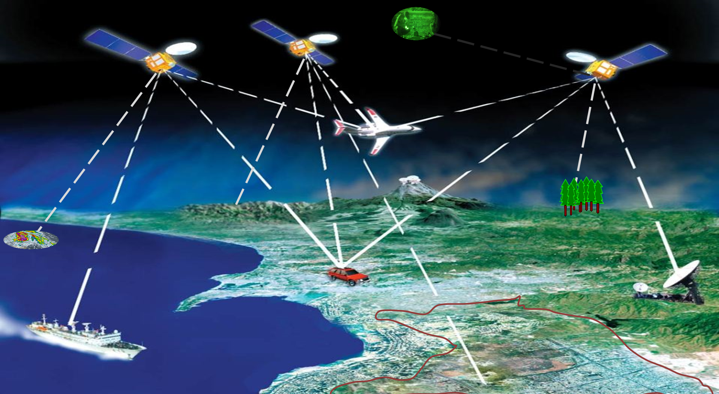


GEO TRACKING
a GPS asset tracking solution
Module: Team Project
Module Leader: Ilioudi Mata

Slide 2

LOADING Please wait…
George Giannakopoulos (Project Manager) – TCP & Web server
George Papakostantinou – Web Application & Login Page
George Karanikas – Relational Database
George Zikas – Graphics design
George Glykas – Administration Pages

Slide 3

Goals
Everyone does their agreed part on time.
Make everything work interoperate properly and as designed.
Build a stable system that can offer its services to the public.
Learn something and have fun from this experience

Slide 4
What it does
Tracks the precise location of whoever or whatever is on hold of the GPS receiver.
Keep historical data of objects’ locations, that can be viewed and mapped on demand later or even live.
Plot a tracker’s route on the map, in a way humanly understandable.
Is viewable and operating from any kind of device, as responsive web design will be utilised.

Slide 5



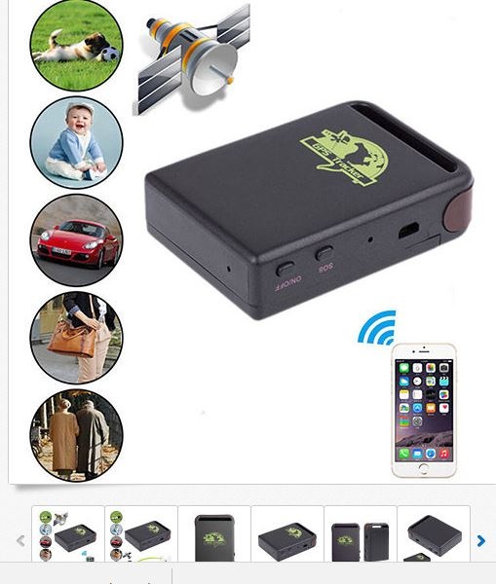



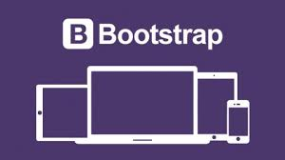
Tools to be Used
MySQL Database
MySQL Workbench
Python 3.5
HTML5, CSS, JS, Bootstrap
GPS Tracker (commercial)

Slide 6
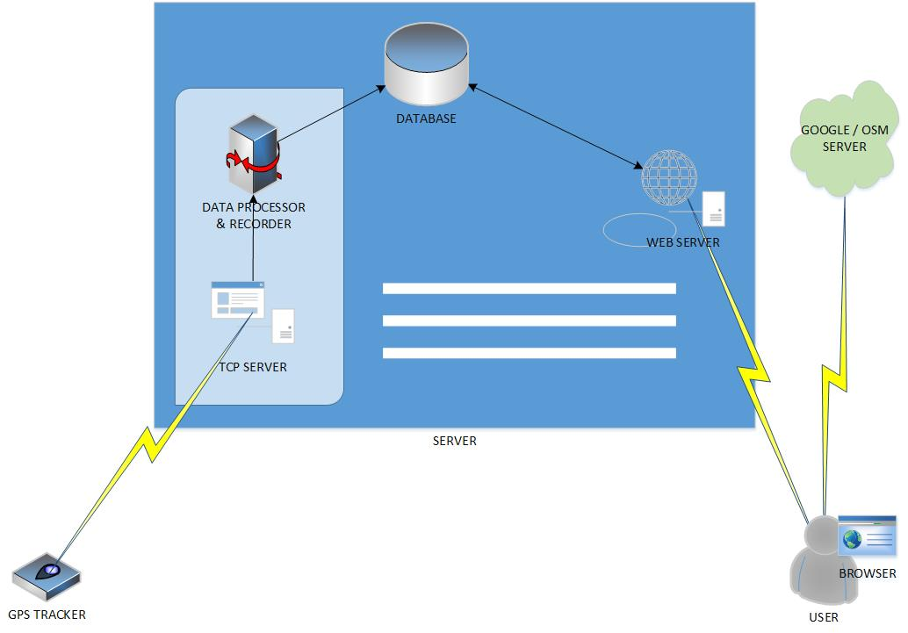
APPLICATION TOPOLOGY

Slide 7
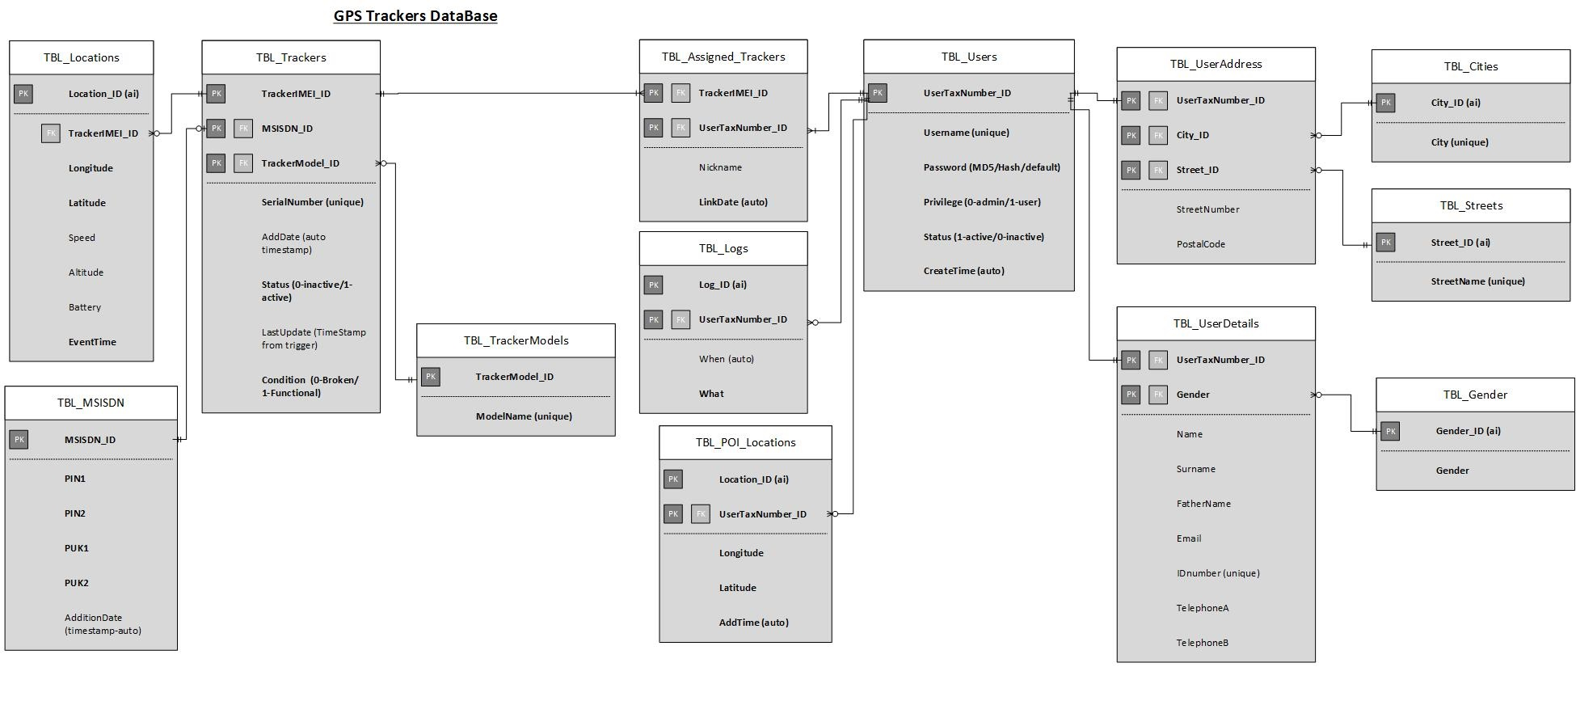
DataBase Entity Relationship Diagram

Slide 8
Intended Market
Users of this system, should be people living next door, that want to be cautious with their vehicles they put effort in acquiring.
Small and large companies alike, that want to monitor their vehicle fleet for security and efficiency reasons.
Pet owners, that want to know where their pets are.
People with low budget in general, due to the low cost of acquisition and maintenance.

Slide 9
Why it’s great
It will be made from a group of college students, that put teamwork and a lot of passion into it and with a little bit of heart they actually did it.
It uses modern technologies that are free, or easy to get.
Low cost makes it easy to build, scalable, easy to maintain and replace its parts.

Slide 10
THANK YOU
FOR YOUR TIME!

